Slide 1
LEADER TRAINING
Our vision :
“To demonstrate God’s love to all who come to camp”

Slide 2
The three S’s
Be SAFE
  At all times it is important that everyone at camp is physically, emotionally and spiritually safe.
Be SEEN
  Leaders must always be visible to others when they are interacting with campers (always have 3 people wherever you go (bathrooms etc)
Be a SERVANT
  As Jesus taught us; we must serve other above ourselves. This is the love he demonstrated to us and how Christians are called to live.

Slide 3
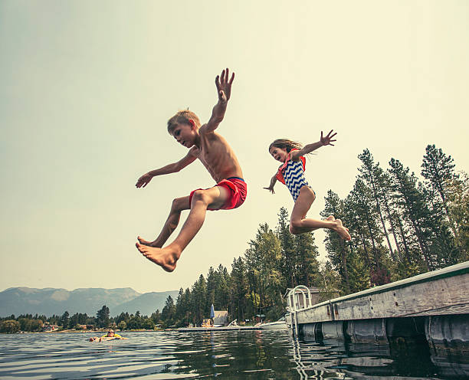
Be SAFE
Be SEEN
Be a SERVANT

Slide 4
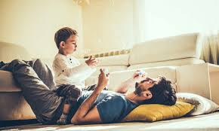
Be SAFE
Be SEEN
Be a SERVANT

Slide 5
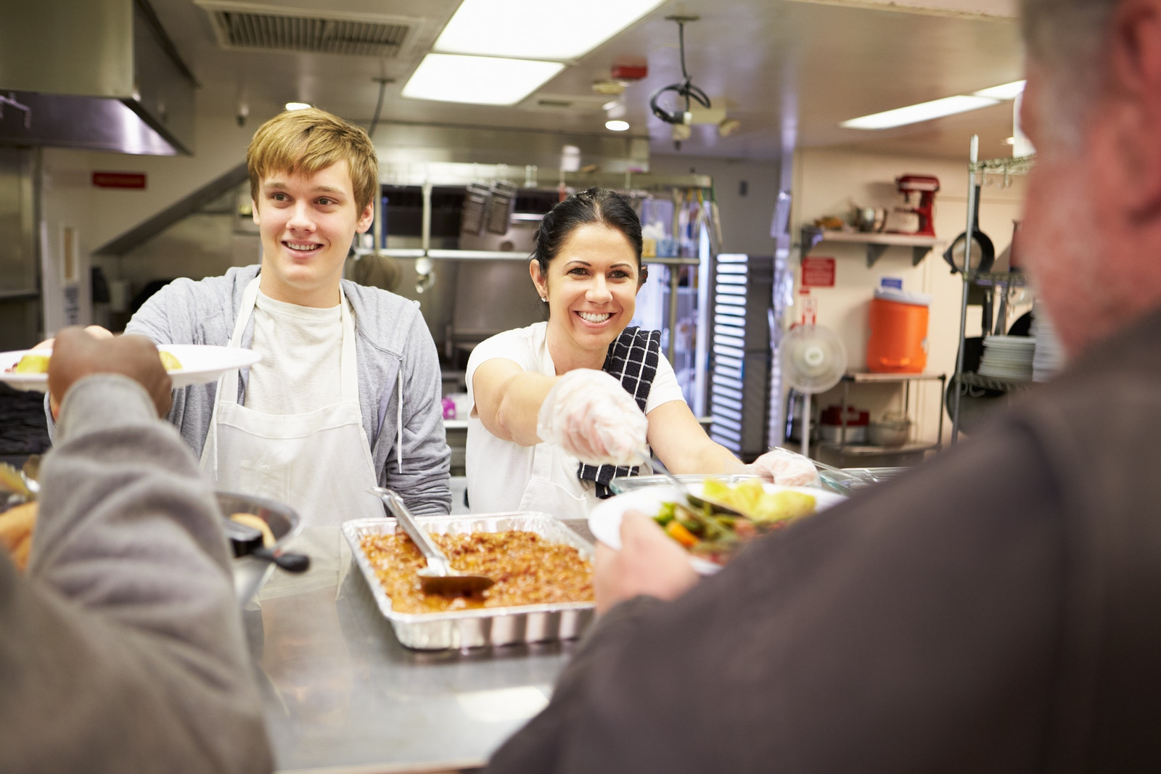
Be SAFE
Be SEEN
Be a SERVANT

Slide 6

Code of conduct
  All visitors must sign in on arrival
  Behaviour should be consistent with that of Bible Believing Christians
  Any vehicles on site must be driven in a sensible and law-abiding manner.
  No PDA
  No campers are allowed in bed with a PA, Leader, Jr Leader or fellow camper.
  Minimum 2 Leaders per cabin
  Camp is smoke, drug and alcohol free.
  Cell phones must be handed in
  Failure to meet these, could result in being asked to leave.

Slide 7
Lost Items
  1st, check again! And again! It’s probably in their bag, calmly have a look with them.
  Still worried? Talk to camp parents or staff.
  Cell phones should be left at home but if brought can be locked in the office.
  Kids can borrow things and forget to return it – so ask who had it last?
  The best way to not lose things is to ask

Slide 8
Nurse
Main Roles :
  Medication
  Injuries that happen at camp that you can’t deal with solo
Near misses...
When something could have been an accident but didn’t quite happen...
  Please let us know!

Slide 9
Meal times
  Hands need to be washed on way to dining room
  Grace in lines outside dining hall
  Hands sanitized on way in
  Dining Hall is for sitting in NOT walking/running around
  Wait for seconds to be announced
  Plates scraped and rinsed then stacked for Duty Team
  Role play what this looks like

Slide 10
Disclosures
  Due to the close relationships, we develop with our campers there is a chance that a camper may disclose that unsafe things are being done or are happening to them at home. While this is unlikely it is important that we are prepared and know what to do if it does happen.
Listen – remain calm and allow the child to speak in their own words.
Reassure – acknowledge that speaking up was the right thing to do.
Do not investigate – avoid leading questions, making assumptions or attempting to establish proof.
Do not promise confidentiality – explain that information may need to be shared with people who can help keep them safe.
Do not confront the alleged person.
Record promptly – document what was seen, heard or disclosed as accurately and promptly as possible.
Report immediately – promptly inform ministry coordinator or camp manager
  This process also applies for if another leader discloses something unsafe happening to them.
  If something unsafe is happening to you please reach out to us, we would love to help.

Slide 11
Creating positive team culture
  You as leaders set the culture of your team. How you act towards your co-leaders, other helpers and campers is generally the behaviour that will be mirrored. Set expectations early.
  Encourage positive behaviour
  Continued Unwanted Behaviour: Leader > Senior Leader > Levi/Melissa/Dave
  We want to see kids who are behaving negatively as soon as possible (even if that means skipping a few levels)
  Reasons to go straight to Levi / Melissa / Dave include serious physical violence, deliberate serious damage to property, racial or sexually explicit comments, child leaving site / running away.

Slide 12
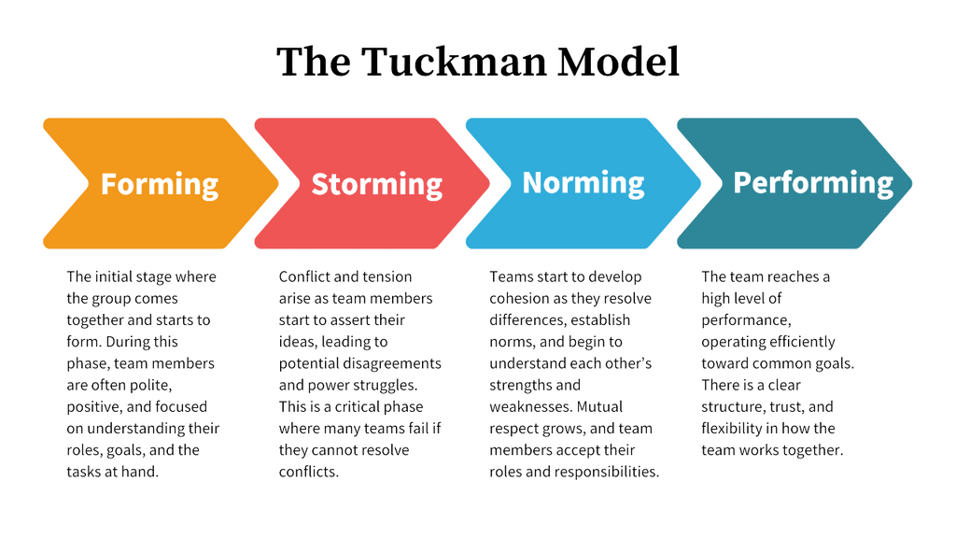

Slide 13







Gossip / bad chat
  Ephesians 4:29 – “Do not let any unwholesome talk come out of your mouths, but only what is helpful for building up others according to their needs, that it may benefit those who listen.”
  Camp is not a place for gossip or unwholesome talk of any kind about anyone
  Ensure discussions about bad behavior are about the behavior and not the camper, hate the behavior but love the person e.g. “Gregg keeps swearing at other members of the group, it’s really frustrating” vs “Gregg is the worst camper in our group, he’s an idiot”
  Keep talk in the leaders lounge camp appropriate, if you wouldn’t talk about it in front of your campers don’t talk about it all.
What kind of convo do we want?
HINT

Slide 14
Toilet / Showering
Make your Prescence known when entering a cabin / bathroom to avoid awkward situations. Knock on the door and ask if you can come in before going into a cabin or bathroom.
In the event that a camper needs assistance in the toilet or shower this should never be done one on one with a leader. Grab another leader or staff member and have them chaperone / assist you. Let the camp coordinator know who you had to help and when it was afterwards.

Slide 15
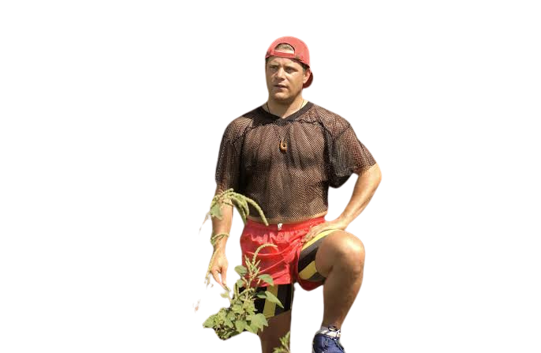
Appropriate clothing
  Ensure as a leader that you are always wearing clothing that is appropriate to camp
  If its cold / wet Wear a hoodie and jacket. You can’t expect campers to do it if you won’t!
  Closed toed shoes for instructed activities
  Susncreen on hot days
  Ensure your clothing is modest and not too revealing
sick fit but not at camp

Slide 16
Camp & social media
  It is not appropriate to add or follow campers on any form of social media. Facebook, Instagram, Tiktok, Snapchat, Messenger etc. It is also not appropriate to accept requests or messages from campers.
  There is a camp leaders group chat and Facebook page. Treat this chat the same as you would a conversation at camp. No gossip, inappropriate chat etc. Do use it for prayer requests and to organise social events!
  It is an expectation that leaders at Camp Columba uphold their Christian values on their social media. Anything deemed as being detrimental to the reputation of Camp Columba on any volunteers’ social media will result in discontinuation of their involvement at camp. For example, getting drunk on an Instagram story.
  Ensure any social media interaction with other leaders / volunteers is appropriate, respectful and loving.
  If someone is behaving towards you or someone else in an inappropriate way on social media, please let us know.

Slide 17
Dating at camp
  Camp is not the place for dating, looking for someone to date or building on a romantic relationship. We come to camp to serve our campers and go closer to God.
  Cuddling regardless of gender is not appropriate. This also applies to leaders’ meetings and breaks.
  Flirting is not appropriate
  We understand that due to the nature of camp some of you may enter a relationship with someone who also attends camp or may already be in one. We are not against this but if that person is your motivation for coming to camp we suggest you reevaluate and reflect on whether you should be coming to camp.

Slide 18
Activities
  Participation – you can’t tell a kid to participate when you’re not.
  Knowing when to let a kid win and when not to!
  Knowing when it’s okay to challenge kids if they’re scared to do something
  Being prepared (warm clothing, proper shoes etc.)
  Options if an activity runs short (games, boardgames, colouring etc.)
Free time
  Structured Free Time
  Keeps them busy in the areas we want them to be
  Allows for time to hang out with other campers and leaders (please don’t clump up in leader groups - interact with the kids!!!)

Slide 19
Growing each other into better leaders
  Holding people accountable
  Encouraging others when they are doing well and when they are tired
  Giving each other tips
  Praying for one another
Breaks
  Introvert vs Extrovert
  Naps, Quiet Time, Socialising with friends
  Keeping Leader Lounge Tidy – Your stuff lives in your room
  If you are struggling and need an extra break let us know!

